Slide 1
Big Mountain Resort Updated Pricing Strategy

Slide 2
Problem Identification
Current pricing strategy: charging premium above the average price of resorts in its market segment
Issue: doesn’t consider other factors, like features offered and visitor information
Additional costs this season: $1,540,000 for additional chair life

Slide 3
Recommendation and Key Findings
- Big Mountain Resort could raise their adult weekend ticket prices to $97.85, which is $16.85 more than their current price of $81.00, based on the features offered. Even with a predicted mean absolute error of $10.15, this model still allows for a modest increase in ticket pricing
- There is support for increasing the ticket price by $2.36 for each additional chair lift added. This is based on the assumption that there will be 350,000 visitors this season, and that each visitor will purchase an average of 5 tickets, resulting in an increase of $4,136,364 in revenue over the entire season
- Some features are pointless to add upon, in terms of increasing revenue to the resort (snowmaking area, increasing longest run)

Slide 4
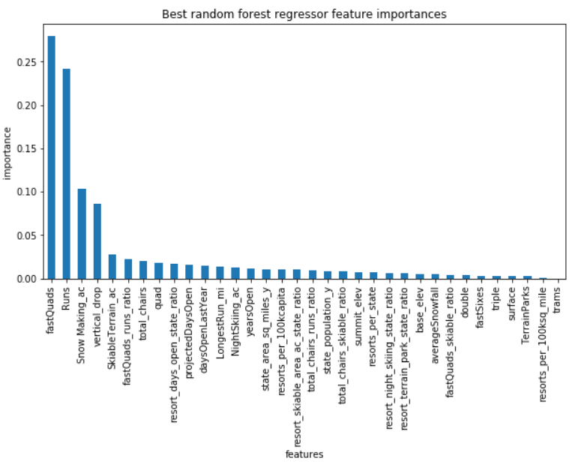
Modeling Results and Analysis (Part 1)
- Random Forest Regression Model was picked due to having a lower error range than the linear model
- Most important features according to this model were fastQuads, Runs, SnowmakingAC, and vertical drop.

Slide 5
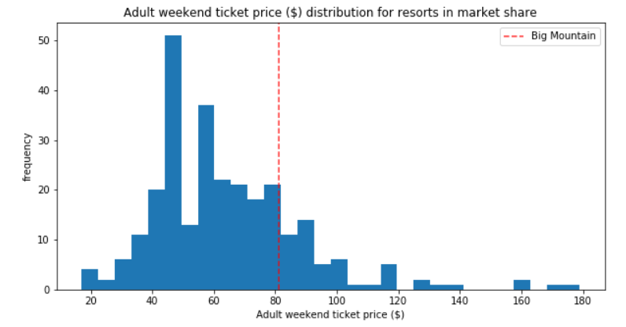
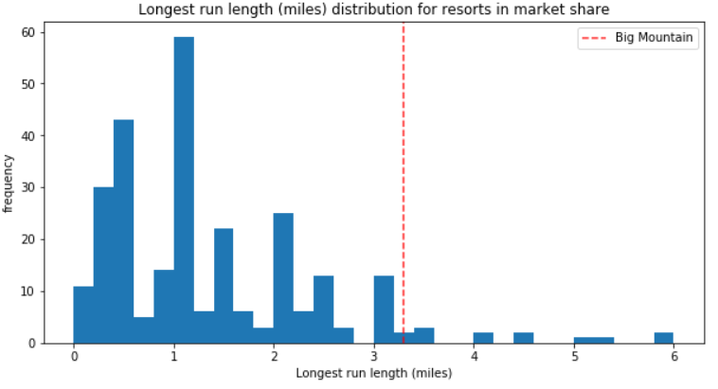
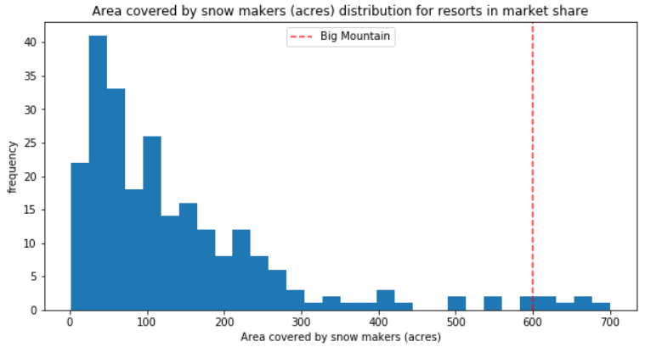
Modeling Results and Analysis (Part 2)
Big Mountain Resort has above average ticket pricing, but its features offered are far above average when compared to other resorts around the country

Slide 6
Modeling Results and Analysis (Part 3)
- Not all features are created equal
- Feature increases that do not warrant any increase in ticket pricing
2 acres in snowmaking acreage
.2 miles increase in longest run

Slide 7
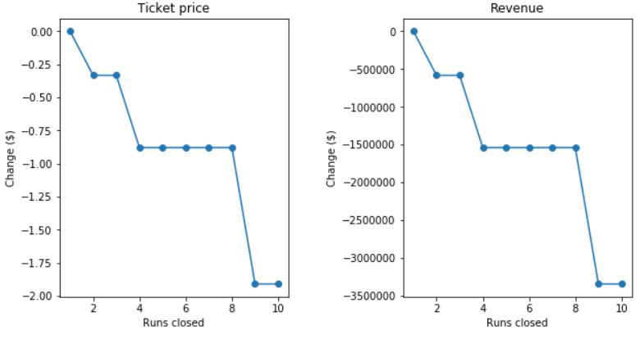
Modeling and Analysis (Part 4)
- Effective feature removal should be done in increments
Closing 4 runs warrants the same decrease in ticket price as 8 runs, so closing 8 runs would be preferable

Slide 8
Summary and Conclusion
Pricing strategy should be updated to include feature information from other resorts
It is safe to say that Big Mountain Resort has room to increase ticket prices by at least a moderate amount given the features it offers
Features should be added or removed based on ticket pricing influence
When adding features, select the ones with stronger influence on ticket price
When removing features, use incremental strategy
Further improvements: Model could be improved with visitor information

